Slide 1

Tech Recommender System
Customized Component Suggestions and db Management

Slide 2
What is a recommender system
Provides personalised suggestions
Objective: improve user engagement on various platrofms
Suggestion can be based on:
Historical behavior (browsing or purchase history)
Preferences (price ranges, product category)
Similar users preferences
Ecc…

Slide 3
collaborative filtering
Used in systems like E-commerce, Video streaming, Audio streaming…
Helps predict interests of a users by using collective knowledge
Principle: recommend to user A items that similar users B and C like.

Slide 4
tech recommender system: overview
Basic computer parts recommender system with users and admin options
Users can
Get recommendations
View and post products ratings
Admins can
View all item in the knowledge base
Insert and delete items from the knowledge base

Slide 5
TECH recommender system components
Facts
Non dynamic
User
Search_history
Dynamic
Category
Price
User_rating
Main rules
Init and menu_switch
User option
Get_recommendation
Recommend
Pearson_correlation
Admin options and db management

Slide 6
facts
User: specify the registered users in the recommendation system
Search_history: used to store the search history of registered users
Category: used to store the category of the components (cpu, gpu, ram)
Price: used to store the price of the components
User_rating: used to store user ratings for components

Slide 7
Rules - Init and menu_switch
Init: rule to execute the program and trigger the main menu
It prints out a menu and reads user selection
User selection is passed to menu_switch rule
Menu_switch(input): lets us choose between
User menu
Admin menu
Exit program

Slide 8
Rules - User option
Calling menu_switch(1) let us enter the user menu
User_option(input): lets us choose between
Get some component suggestions (get_recommendation rule)
Leave reviews to components
Check the reviews of the various components
Go back to the main menu

Slide 9
Rules - Admin options
Calling menu_switch(2) let us enter the admin menu
Admin_option(input): lets us operate the database:
View all the facts
Insert a new component in the knowledge base (assert)
Delete a component from the knowledge base (retractall)
Go back to the main menu

Slide 10
Rules - Get_recommendation
Asks for username
Prompt the user to enter min and max price and a category (cpu, gpu, ram)
If category is skipped (skip), is the system to choose a category
Calls recommend predicate with the above parameters
Presents results to user

Slide 11
Rules – recommend generates recommendations based on search history, preferences, and ratings.
Checks user’s history to find product matches with preferences
Get similar users exploiting ratings similarity between the two users
Generate collaborative recommendations
Merge collaborative recommendations and history matches
Format recommendations for user-friendly output
Make use of helper rules to perform task

Slide 12
Rules – recommend – main helper rules
Find_matching_products
filter and identify relevant products for a user based on their search history and preferences
Find_similar_users
Uses Pearson Correlation coefficient to find similar user based on their product ratings, essential input for collaborative filter
Generate_collaborative_recommendations
For every similar user, it looks for products with rating > 4.0 and returns them

Slide 13
Rules - Pearson_correlation used to help find similar users
Pearson correlation express similarity between two sets of data
Calculates the Pearson correlation between two lists of user ratings
Used inside the recommend - find_similar_user rule to find similar users
Make use of helper rules to perform task too

Slide 14
conclusions
The system provides custom hardware products recommendations
Recommendations are created using history and collaborative filtering
User friendly interfaces with menus let us operate the system efficiently
Administrators can edit the knowledge base to keep system up-to-date

Slide 15
Possible improvements
Implement effective user and admin authentication
Improve code by using more error checking mechanisms
improve system by adding other recommending criteria
More preferences
Feedback
Social connections
Ecc…

Slide 16
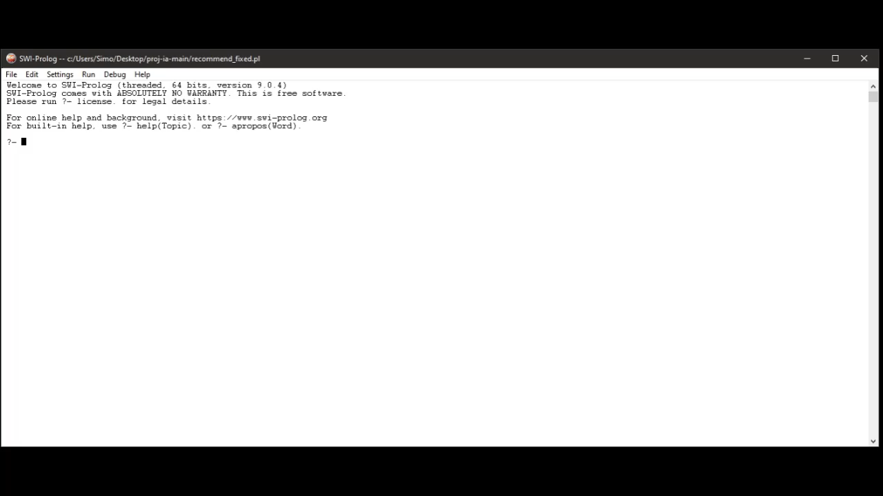

Slide 17
THANK you for your attention

